Slide 1
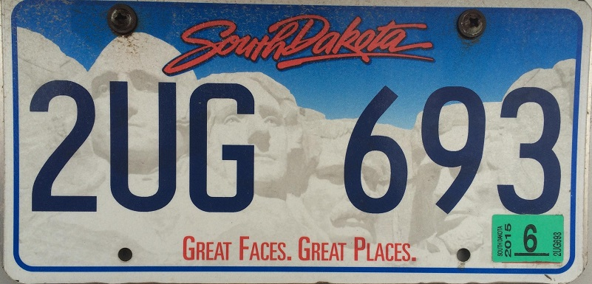
License Plate Sequence Extraction
Using Template Matching and
The Hough Transform
Lauren Keene, Kayhan Karatekeli, Luke Meyer

Slide 2
Overview
Project Premise
Template Matching
  General Idea
  Implementation
Hough Transform
  General Idea
  Implementation
Results

Slide 3
Project Premise
Extract the numbers and letters from a direct photo of a license
plate using two different methods
Method 1: Template Matching
  Using a normalized correlation coefficient, numbers and letters will be found using a system of templates derived from license plate pictures. Characters with high correlations will have their correlations printed to screen.
Method 2: Hough Transform
  A generalized Hough transform will be used to determine the shapes of letters and numbers. Preconstructed templates will be used for this process as well. *****Characters with high correlations will have their accumulator array scaled from 0 – 255 and printed to screen.
Each process will print to screen two things
1. the alphanumeric sequence extracted
2. the time needed to determine the sequence

Slide 4
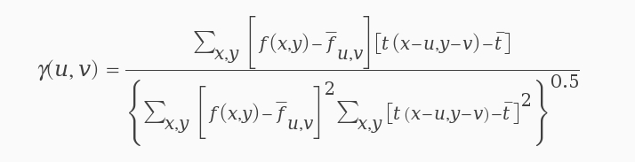
Template Matching General Description
What is template matching?
  A process used to find specific features in an image by using a system of templates.
Process
  drag a template over every position in an image
  determine correlation coefficient
  if correlation is over a specific threshold, match found

Slide 5


Template Matching Implementation (part 1)
Templates
  each alphanumeric character was
  given a system of 5 templates
  each of these 180 templates was
  read in and dragged across a license
  plate image
Correlation
if a correlation was over 73.5% it was recorded as a match
  each match had all information recorded in a system of arrays
Character Value | 'T' | '' | '' | '' | '' | '' | ''
Column | 46 | 0 | 0 | 0 | 0 | 0 | 0
Correlation | .813 | 1 | 1 | 1 | 1 | 1 | 1

Slide 6
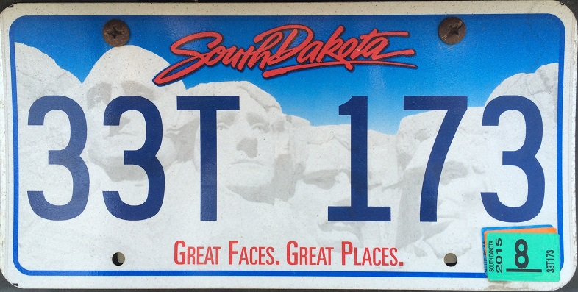
Template Matching Implementation (part 2)
Multiples
characters may have high correlations
in a neighborhood, not just one pixel
Character Value | '3' | '3' | '3' | '3' | '3' | '3' | '3'
Column | 6 | 7 | 6 | 6 | 112 | 113 | 113
Correlation | .813 | .790 | .836 | .804 | .752 | .891 | .810
Characters will be recorded if there is no check to analyze the position of the character
To fix this, an if statement is implemented to make sure that a new character cannot be stored if within width/2 of a previously recorded character
Character Value | '3' | '3' | '3' | '' | '' | '' | ''
Column | 6 | 113 | 658 | 0 | 0 | 0 | 0
Correlation | .813 | .891 | .812 | 1 | 1 | 1 | 1

Slide 7
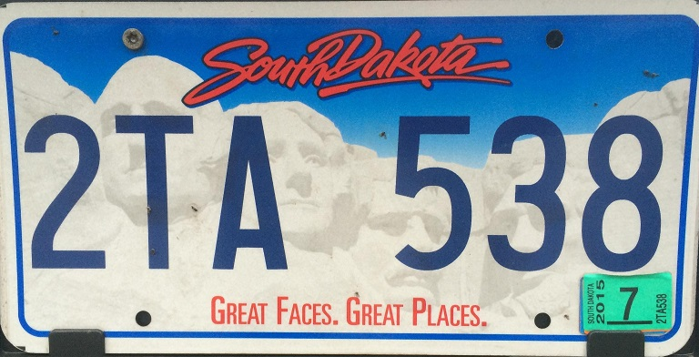
Template Matching Implementation (part 3)
Similar Characters
some characters may be
read as other characters
Character Value | '2' | '3' | '3' | '5' | '' | '' | ''
Column | 7 | 550 | 658 | 444 | 0 | 0 | 0
Correlation | .813 | .790 | .736 | .823 | 1 | 1 | 1
An error is placed into the table due to its high correlation
If an '8' template is then read at column 660 with a correlation of .853
Due to its higher correlation it will replace the mistaken match for the better one
'8'
660
.853
Character Value | '2' | '3' | '8' | '5' | '' | '' | ''
Column | 7 | 550 | 660 | 444 | 0 | 0 | 0
Correlation | .813 | .790 | .853 | .823 | 1 | 1 | 1

Slide 8
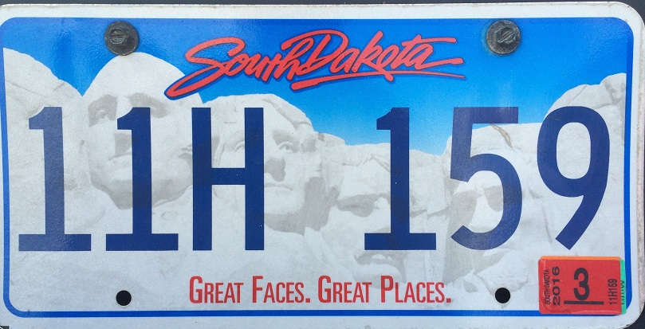
Template Matching Implementation (page 4)
After all templates have been run
Character Value | '5' | '9' | 'H' | '1' | '1' | '1' | ''
Column | 550 | 658 | 216 | 7 | 111 | 444 | 0
Correlation | .813 | .790 | .736 | .823 | .795 | .850 | 1
Items found will be sorted by column before being printed to the user
Time to completion will also be printed to user
Character Value | '1' | '1' | 'H' | '1' | '5' | '9' | ''
Column | 7 | 111 | 216 | 444 | 550 | 658 | 0
Correlation | .823 | .795 | .736 | .850 | 550 | .790 | 1

Slide 9
Hough Method General Description

Slide 10
Hough Method Implementation

Slide 11
Results

